Slide 1
GROUP I
PROJECT PRESENTATION

Slide 2
GROUP MEMBERS
NAME
INDEX NUMBER
ABALO EMMANUEL KOFI
ERNEST ANSAH
4182420
4194820

Slide 3
OUTLINE
INTRODUCTION
OBJECTIVES
RELATED WORKS
PROPOSED WORK
METHODOLOGY
CONCLUSION
REFERENCES

Slide 4
INTRODUCTION
The world is hardly lived without communication.
According to the World Health Organization, over 5% of the world’s population suffers from disabling hearing loss.
In Ghana, it’s 1.7% percent of the population, or 470,737 people. In some rural communities, there are children who are deaf who have little or no spoken language or sign language ability and a lack of access to inclusive educational opportunities.
Sign Language is not essentially known to a more significant portion of the human population who uses spoken and written language for communication.
It is a necessity to develop technological tools for interpretation of sign language.
The foundation of communication in sign language is the representation of emotions through visual sign patterns (Arpita and Arkshit, 2021).

Slide 5
INTRODUCTION
We are inclusive and will want to bridge the communication barriers between sign language users and those who do not understand it.
This not only complies with accessibility accommodation requirements but also with growing market demand for emerging solutions across sectors.
For this reason we decided to develop a strong and accurate sign language identification app using deep learning and MediaPipe.

Slide 6
OBJECTIVES OF THE PROJECT
Data Collection and Preparation
Choosing and implementing a model architecture
System Building
Implementation and Design of the User Interface
Optimization and Fine-Tuning
Documentation

Slide 7
RELATED WORKS
In 1991, Murakami and Taguchi presented a study that used neural networks for the first time to recognize sign language.
As the science of computer vision advanced, several researchers devised new strategies to support the community of people with physical disabilities. Wang and Popovic in 2009 created a real-time hand tracking program using coloured gloves.
By using the feature extraction technique, specific features about the pixel data from images may be extracted and fed to CNN, facilitating quicker training and improving prediction accuracy. W. Liu et al. in 2015 tracked hands in both 2D and 3D space.
To train a machine learning model, R. Sharma et al (2020). employed 80000 distinct numeric signs, each with more than 500 photos. A training library of previously processed photos is used in their system technique to train both a gesture recognition and a hand detection system.

Slide 8
PROPOSED WORK
This project suggests a deep learning-based solution for detecting and interpreting sign language.
The goal is to facilitate communication between deaf or hard-of-hearing individuals and non-signers by providing real-time sign recognition and interpretation.

Slide 9
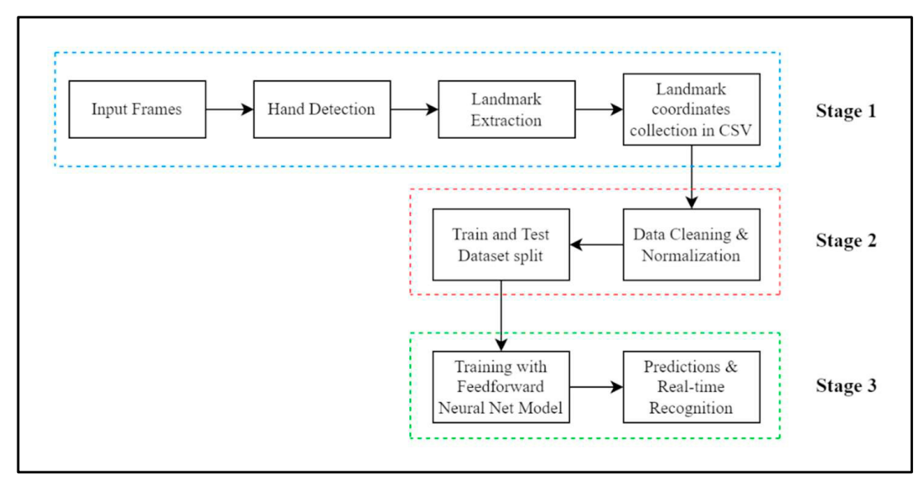
METHODOLOGY

Slide 10
CONCLUSION
This work attempts to provide a visual solution for the sign language recognition problem.
A state-of-the-art methodology has been adapted to implement the solution using advanced tools like MidiaPipe.
The classification results claim that compared to other models in the literature, which require high computation power and longer training time, this approach of sign language recognition using the MediaPipe hand tracking solution is more effective and faster for classifying complex hand signs and gestures including alphabets.
Also, due to its lightweight characteristic, the model becomes more robust and can be implemented over various computing devices with different computing power without losing speed and accuracy.

Slide 11
REFERENCES
Arpita Haldera, Akshit Tayade 2021. Real-time Vernacular Sign Language Recognition using MediaPipe and Machine Learning. https://www.researchgate.net/profile/AkshitTayade-2/publication/369945035_Realtime_Vernacular_Sign_Language_Recognition_using_MediaPipe_and_Machine_Learning/links/643605da20f25554da283357/Real-time-Vernacular-Sign-LanguageRecognition-using-MediaPipe-and-Machine-Learning.pdf
Murakami K, Taguchi H. 1991. Gesture recognition using recurrent neural networks. In: Proceedings of the ACM SIGCHI conference on Human factors in computing systems, pp 237–242. https://dl.acm.org/doi/pdf/10.1145/10884 4.10890 0
Wang RY, Popović J. 2009. Real-time hand-tracking with a color glove. ACM Trans Graph 28(3):63
R. Sharma, R. Khapra, N. Dahiya. June 2020. Sign Language Gesture Recognition,
pp.14-19
W. Liu, Y. Fan, Z. Li, Z. Zhang. Jan 2015. Rgbd video based human hand trajectory tracking and gesture recognition system in Mathematical Problems in Engineering

Slide 12
THANK YOU

